Slide 1
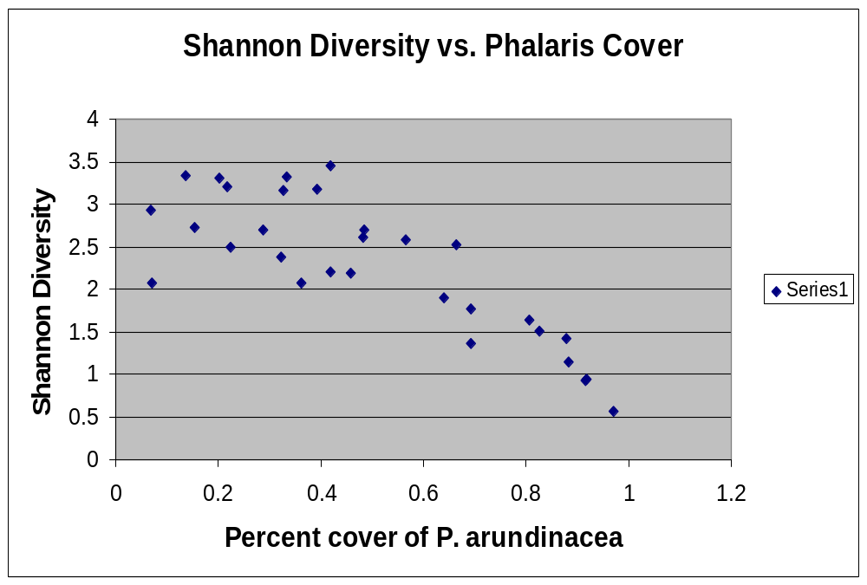
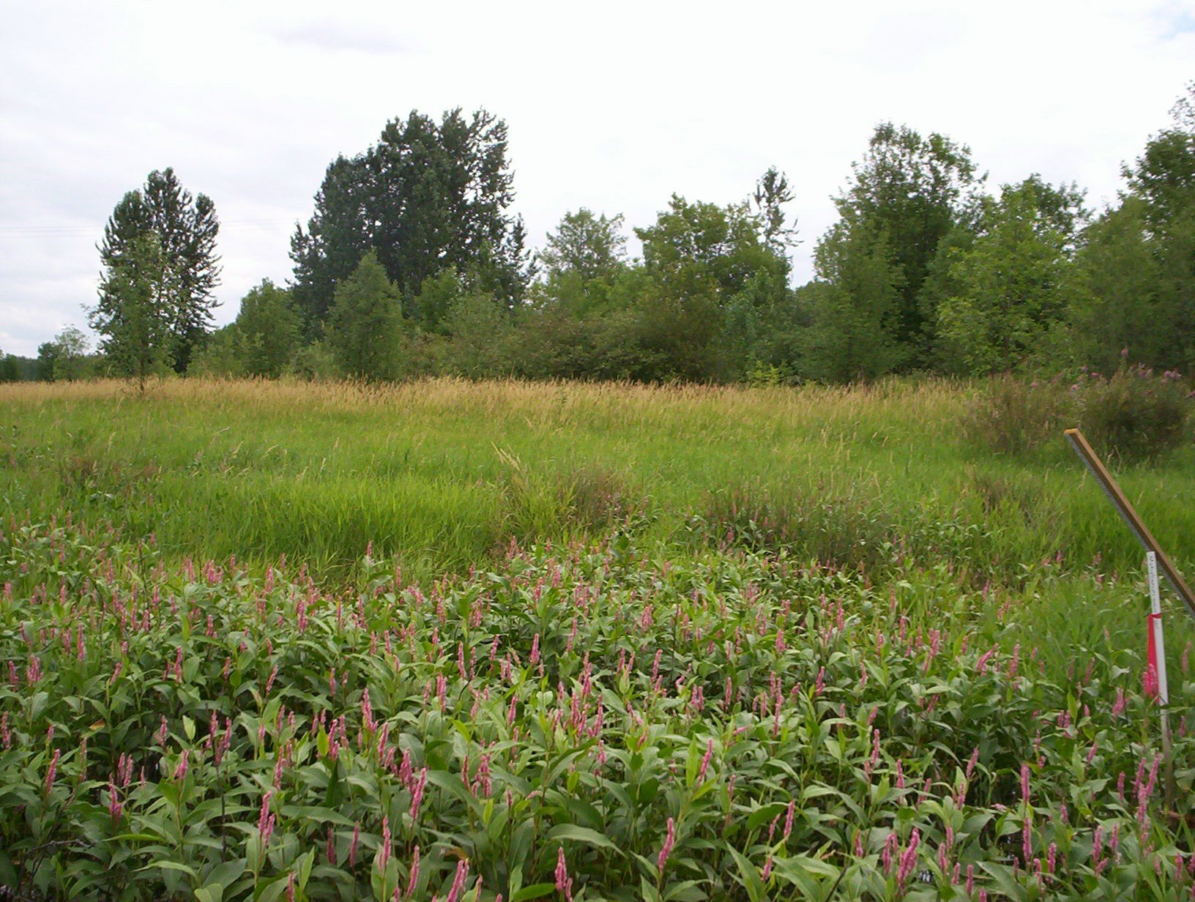
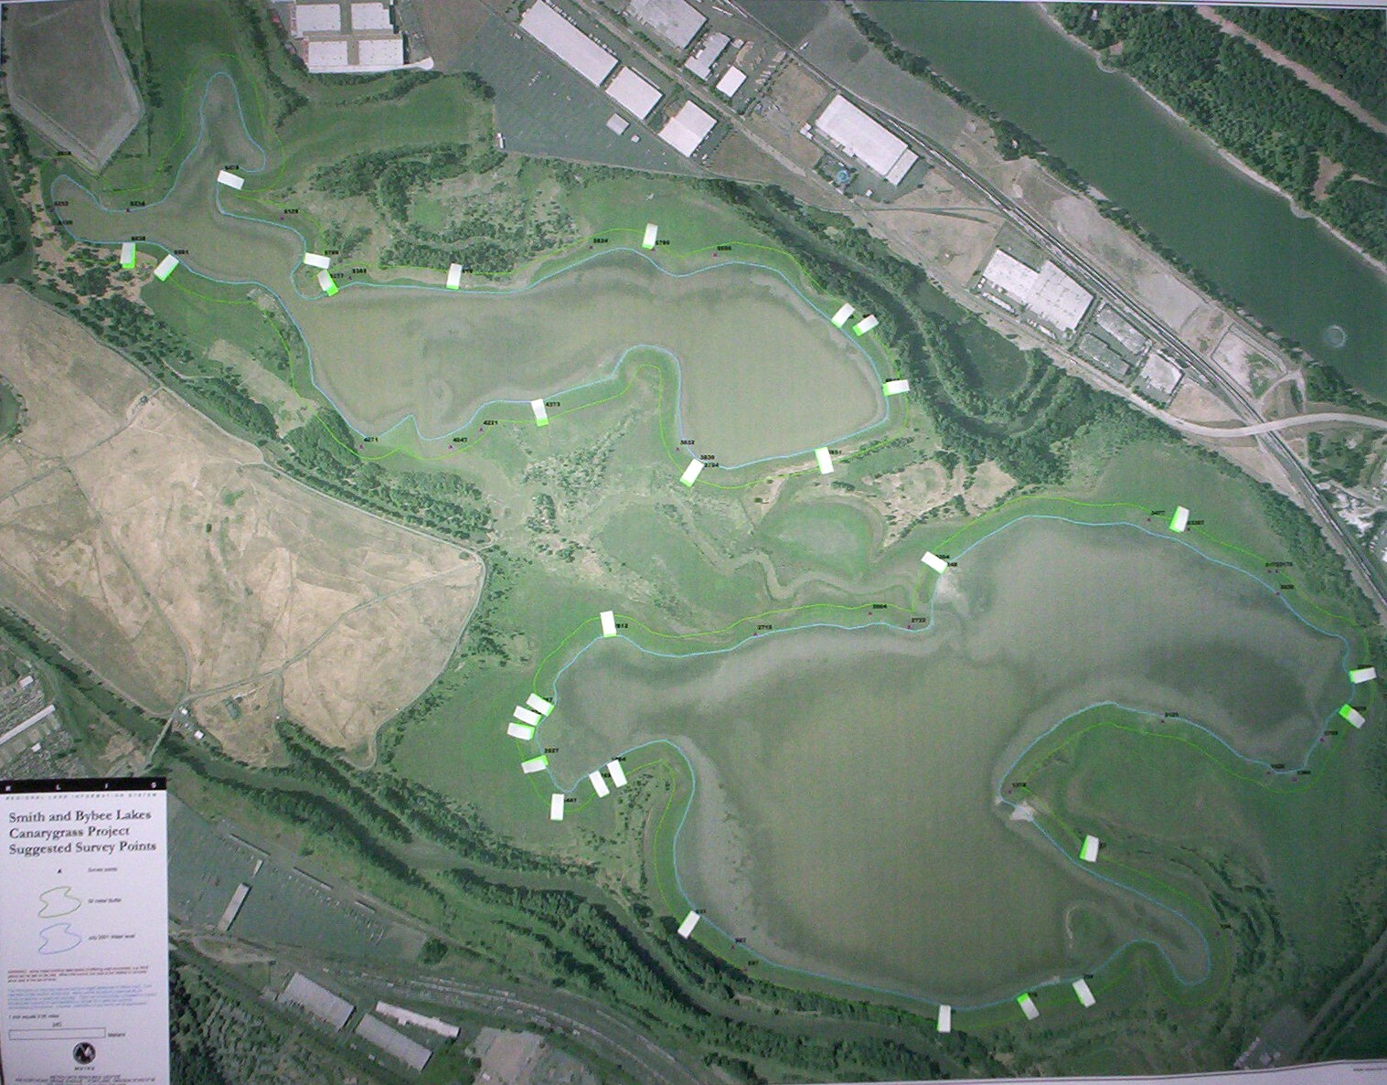
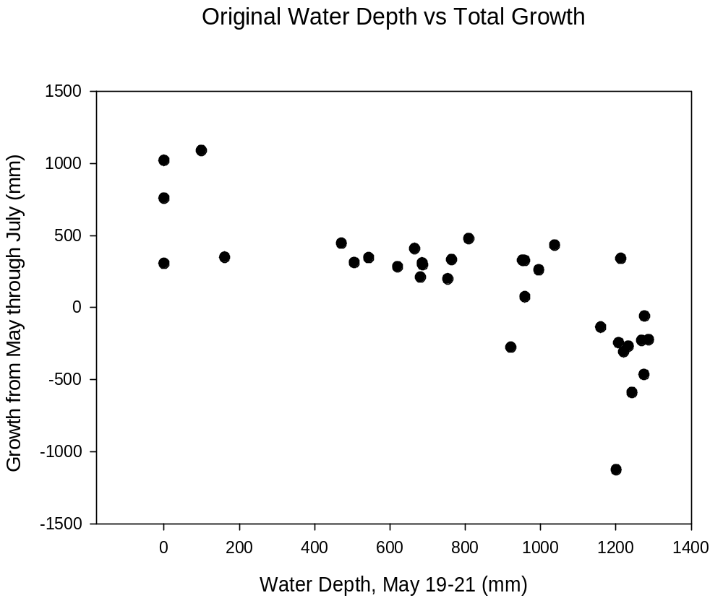
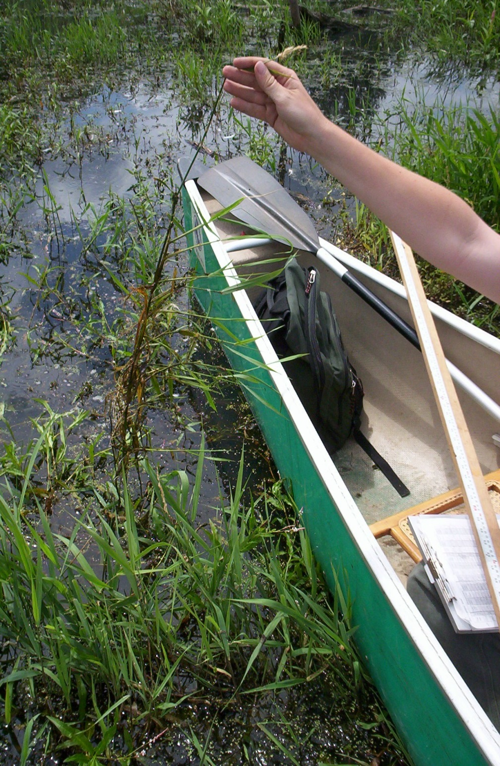
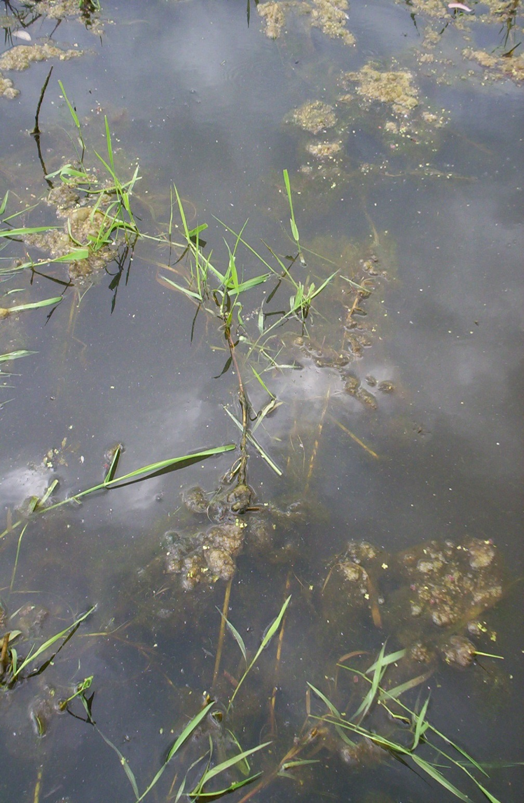
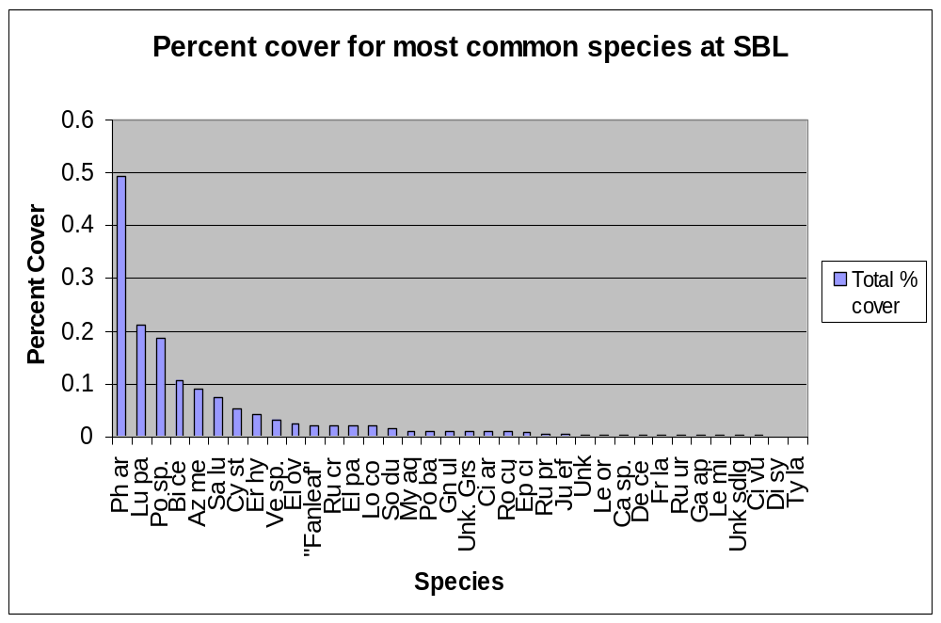
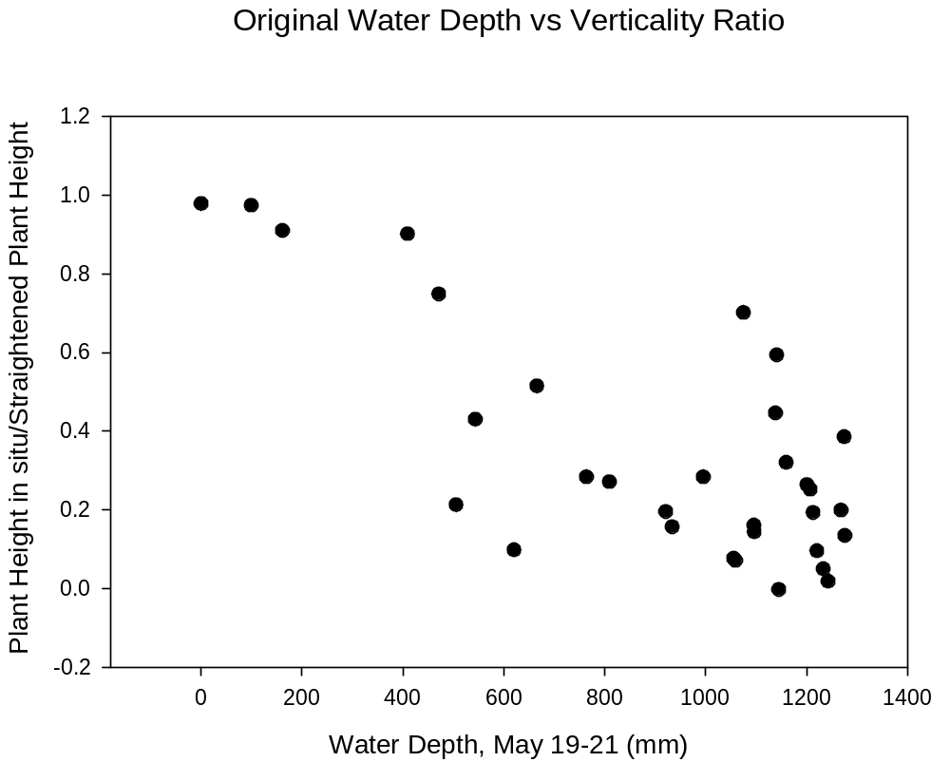
Effects of managed flooding on an invasive plant species in shoreline vegetation communities in a Pacific Northwest wildlife preserve
Noah Jenkins¹, J. Alan Yeakley¹, Elaine Stewart²
¹Portland State University, Portland, OR 97207-0751 USA; ²Metro, 600 NE Grand Ave, Portland, OR 97232 USA
Abstract
Water level management efforts in the Smith and Bybee Lakes Wildlife Area (SBL), an 800 ha preserve in the Columbia Slough area of North Portland, Oregon, include using a newly-established water control structure to suppress invasive reed canarygrass (Phalaris arundinacea L.) by flooding during spring and early summer growth periods. We sought to determine: (a) the present extent and distribution of reed canarygrass at SBL, particularly on lands that will be affected by the change in water regime; (b) the effectiveness of the change in water level at suppressing reed canarygrass; and c) the effects of the change in water level on other plant species distributions. Prior to seasonal flooding during the dry season in autumn 2003, we established 30 vegetation transects at SBL. These transects were distributed randomly throughout SBL, placed perpendicularly to the shorelines of the wetlands. Measurement of vegetation was conducted using the line intercept method at 10 cm intervals. Our baseline measurements showed that reed canarygrass averaged 49% cover in the shoreline areas of SBL. This invasive plant had a strong impact on plant diversity; nonparametric statistical correlation of reed canarygrass cover with Shannon diversity yielded a Spearman’s rho value of - 0.77 (P<0.05). Subsequent measurements of these transects during 2004 will allow us to determine the effect of flooding on reed canarygrass growth and extent. Measurements of reed canarygrass stands during the 2004 growing season indicate a reduction in mid-season growth and alteration of growth habit for inundated patches as compared to upland stands.
The Study Site
Figure 1. Aerial photo of Smith and Bybee Lakes Wildlife Area,
taken July 2001. Transects for the present study are marked in white
Figure 3. Effect of reed canarygrass on species diversity.
Spearman’s rho = -0.77, significant at α = 0.05
Figure 5a. Upland reed canarygrass stand,
unaffected by flooding
Experimental Design
Growth Rate Results
Transects
30 vegetative transects; line-intercept, 10-cm step
20 to 280 m; 102 m mean; total length 3082 m
Monitored in Oct-Dec 2003
Monitor again in Fall 2004; use Mann-Whitney test to
determine differences in % cover at α = 0.05
Growth Rate
43 reed canarygrass stands; 5 replicate measurements per stand
Monitor indicators of reed canarygrass vigor: plant height, stem orientation, number of shoots, shoot height
Correlate growth rate and plant health with degree of inundation
Figure 5b. Impact of flooding on reed canarygrass growth
Figure 4a. Effect of maximum inundation on growth of reed canarygrass stands from May-July 2004
Conclusions
Transect Results
Reed canarygrass is dominant at Smith and Bybee Lakes, and has a significant impact on plant diversity
After early-season pulse of vertical growth, inundated stands grew more slowly than upland stands
The first season of flooding has changed the growth habit of severely inundated reed canarygrass stands
Objectives
Primary objective:
Control reed canarygrass (Phalaris arundinacea L.) by flooding during spring and early summer growth periods
Secondary objective:
Support native emergent and bottomland hardwood plant communities via annual drawdown
References
Antieau, C.J. 2003. Biology and management of reed canarygrass, and implications for ecological restoration. Washington State Department of Transportation, Seattle, WA.
Barnes, W.J. 1999. The rapid growth of a population of reed canarygrass (Phalaris arundinacea L.) and its impact on some riverbottom herbs. Journal of the Torrey Botanical Society, Vol. 126, No. 2, pp. 133-138.
Paveglio, F.L. and Kilbride, K.M. 2000. Response of vegetation to control of reed canarygrass in seasonally managed wetlands of southwestern Washington. Wildlife Society Bulletin 28: 730-740.
Pojar, J. and MacKinnon, A. (eds) "Plants of the Pacific Northwest Coast". Lone Pine Publishing, 1994
Stannard, M. and Crowder, W. 2001. Biology, history, and suppression of reed canarygrass (Phalaris arundinacea L.) USDA-Natural Resources Conservation Service, Technical Notes, Spokane, WA.
Figure 2. Species distribution at Smith and Bybee Lakes
before managed flooding
Figure 4b. Effect of maximum inundation on reed canarygrass stem orientation (1 = vertical; 0 = horizontal)

